Slide 1
Complexity & Limitations of Algorithms

Slide 2
How Good Is An Algorithm?
Selection Sort: O(n²)
Decrease & Conquer Towers of Hanoi: O(2^{n})
O(n²) is generally a good efficiency class and O(2^{n}) is generally a bad one.
But … could either task be accomplished more efficiently?
Knowing bound tells us what kind of improvement to aim for: constant factor or efficiency class
Bound is tight if an algorithm already exists from that efficiency class.

Slide 3
Establishing Lower Bounds

Slide 4
Trivial Lower Bounds
Count number of input items that must be processed / number of output items that must be produced.
e.g. algorithm for producing permutations of n Є Ω(n!) – output size.
Bound is tight – Decrease and Conquer algorithm (4.3)

Slide 5
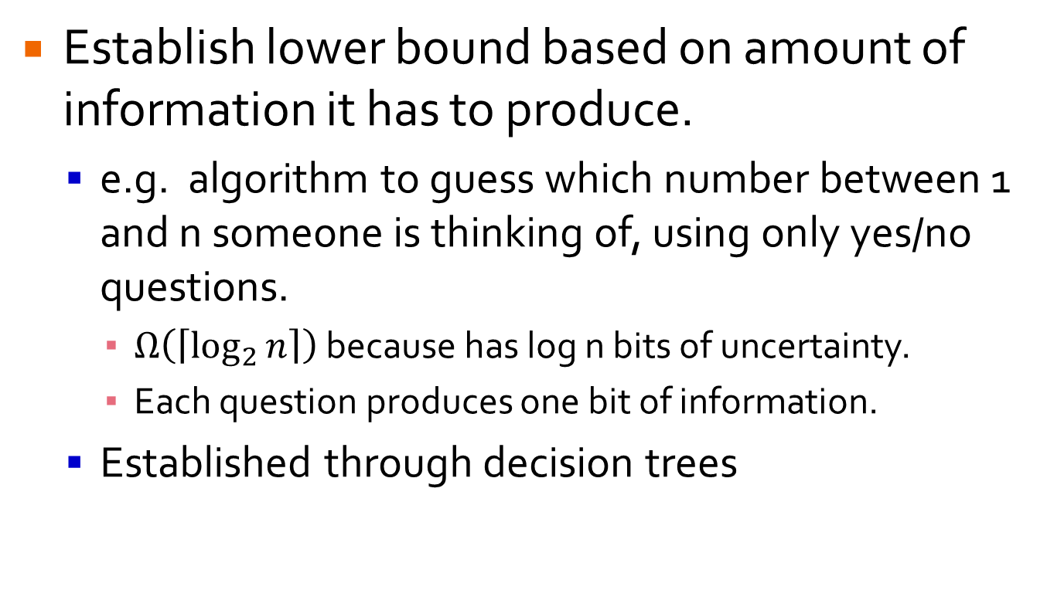
Information-Theoretic Bounds
Establish lower bound based on amount of information it has to produce.
e.g. algorithm to guess which number between 1 and n someone is thinking of, using only yes/no questions.
$Ω\left(\left\lceil \log_{2}{n}\right\rceil \right)$ because has log n bits of uncertainty.
Each question produces one bit of information.
Established through decision trees
Notes:
Based on information theory

Slide 6
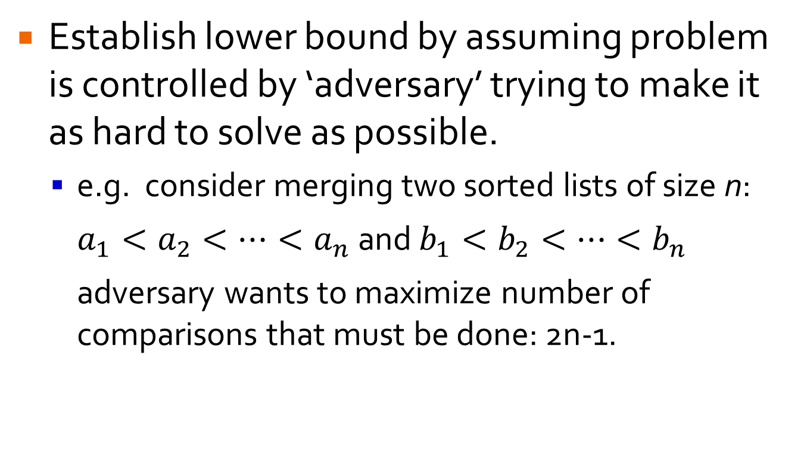
Adversary Method
Establish lower bound by assuming problem is controlled by ‘adversary’ trying to make it as hard to solve as possible.
e.g. consider merging two sorted lists of size n: $a_{1}<a_{2}<…<a_{n}$ and $b_{1}<b_{2}<…<b_{n}$ adversary wants to maximize number of comparisons that must be done: 2n-1.

Slide 7
Problem Reduction
Show that problem P is at least as hard as problem Q by reducing problem Q to P (not other way round!!)
P: Euclidean Minimum Spanning Tree Problem – given n points in Cartesian plane, construct tree of minimum total length connecting all points.
Q: Element Uniqueness Problem – given n values, check whether there are any duplicates. Ω(n log n)
How to reduce Q to P?

Slide 8
Problem Reduction
Transform n real numbers – x₁, x₂, …, x_{n} – to n points – (x₁, 0), (x₂, 0), …, (x_{n}, 0)
Create Euclidean Minimum Spanning Tree, T.
Traverse T and check for an edge of length 0.
Proves that Euclidean Minimum Spanning Tree problem is Ω(n log n)

Slide 9
Problem Reduction
Common problems to reduce to:
Problem | Lower Bound
Sorting | Ω(n log₂n)
Searching a sorted array | Ω(log₂n)
Element uniqueness problem | Ω(n log₂n)
Multiplication of n-digit integers | Ω(n)
Multiplication of nxn matrices | Ω(n²)
Notes:
Last two are trivial lower bounds only

Slide 10
Tractable vs. Intractable

Slide 11
Polynomial Time
An algorithm solves a problem in polynomial time if its worst-case time efficiency belongs to O(n^{d}).
Note: Θ(log n) Є O(n)
Tractable: problem that can be solved in polynomial time.
Intractable: problem that cannot be solved in polynomial time, e.g. O(2^{n})

Slide 12
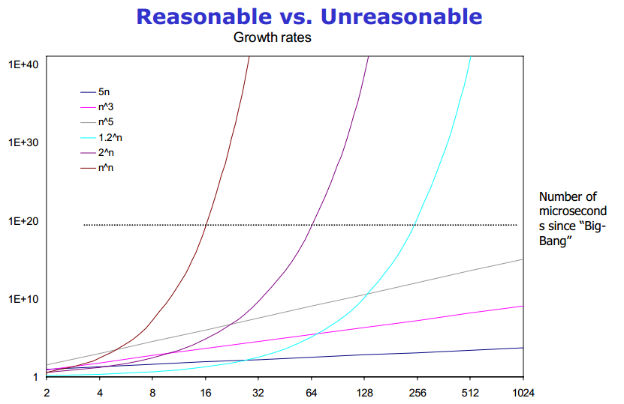
Why Cutoff At Polynomial?
Too Slow!!
Notes:
Intractable qualitatively different.

Slide 13
Why Cutoff At Polynomial?
Few useful polynomial time algs > O(n³). (And few with large coefficients.)
Convenient to combine polynomial functions: sum, composition also polynomial.
Intractable problems are intractable under all principal models of computation.

Slide 14
Decision Problems
A decision problem is a problem that has a yes/no answer.
P is the class of decision problems that can be solved in polynomial time by deterministic algorithms.
Focus on decision problems eliminates problems with exponentially large output.
Many non-decision problems can be re-framed as decision problems, e.g. m-coloring problem.
Notes:
Much of complexity theory focuses on decision problems

Slide 15
Decision Problems
Can every decision problem be solved in polynomial time?

Slide 16
Decision Problems
Can every decision problem be solved in polynomial time? No.
Some problems are undecidable meaning they can’t be solved by any algorithm in finite time.
e.g. Halting Problem: given a computer program and an input to it, determine whether the program will halt on that input or continue running indefinitely.

Slide 17

Halting Problem is Undecidable
Assume algorithm A solves halting problem.
Create a new program Q, whose behavior is:
What happens if we run Q(Q)?

Slide 18
Halting Problem is Undecidable
Assume algorithm A solves halting problem.
Create a new program Q, whose behavior is:
What happens if we run Q(Q)? Contradiction!

Slide 19
Problem Classifications
Few Problems KNOWN To Go Here, But …
Undecidable
Decidable
Tractable

Slide 20
(In)Tractable???
Many important problems have no known polynomial time algorithm, BUT haven’t been proven intractable, e.g.
Hamiltonian Circuit Problem: determine whether given graph has path from vertex to self passing through all other vertices.
Travelling Salesman Problem: find shortest Hamiltonian circuit in complete graph with positive integer weights.

Slide 21
(In)Tractable???
Many important problems have no known polynomial time algorithm, BUT haven’t been proven intractable, e.g.
Knapsack Problem: find most valuable subset of n items with positive integer weights and values that fit into fixed capacity knapsack.
Partition Problem: given n positive integers determine if possible to partition them into 2 disjoint sets with same sum.

Slide 22
(In)Tractable???
Many important problems have no known polynomial time algorithm, BUT haven’t been proven intractable, e.g.
Bin-Packing Problem: given n items with positive sizes, pack them into smallest number of bins.
Graph-Coloring Problem: find smallest number of colors needed to color vertices of graph so no adjacent vertices are same color.
Integer Programming: linear programming with requirement that variables have integer values.

Slide 23
These Problems
Exponential growth of choices relative to input size, n.
Eulerian Circuit (traverse all edges) oddity for being in P.
Checking whether proposed solution solves problem: polynomial time.
e.g. verify list of vertices a Hamiltonian circuit.

Slide 24
NP
NP is the class of problems that can be solved by nondeterministic polynomial algorithms.
Nondeterministic algorithm: randomly generates a candidate solution and then verifies it.
Nondeterministic Polynomial algorithm: nondeterministic algorithm with polynomial time verification process.

Slide 25

P vs. NP
Problems in NP:
All problems in P also in NP – ignore guess and use regular algorithm in “verification” stage.
(In)Tractable??? Problems all in NP.
Halting Problem not in NP.
Most Important Open Question in CS:

Slide 26

NP-Complete
A decision problem, D, is NP-Complete if:
It belongs to the class NP.
Every problem in NP polynomially reducible to D.
CNF-satisfiability problem first to be proven NP-complete.
Now can reduce a known NP-complete problem to D.
Definition implies finding solution to one NP-complete problem gives solution to all.
Notes:
LOTS more detail in COMP 147

Slide 27
Tackling NP-Hard Problems
Two approaches to difficult combinatorial problems (NP-hard):
Use a strategy that guarantees solving problem exactly but doesn’t guarantee finding a solution in polynomial time
Use an approximation algorithm that can find an approximate (sub-optimal) solution in polynomial time

Slide 28
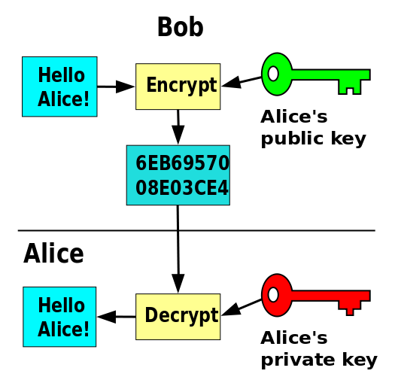

Lemonade from Lemons
Notes:
By Davidgothberg Public Domain, https://commons.wikimedia.org/w/index.php?curid=1028460

